Slide 1


Project 6 K-Nearest Neighbors
Marianne Diniz & Taline Nóbrega

Slide 2


AGENDA
INTRODUCTION
THE DATA
ANALYZING LOCATIONS
ANALYZING TYPES

Slide 3


INTRODUCTION

Slide 4
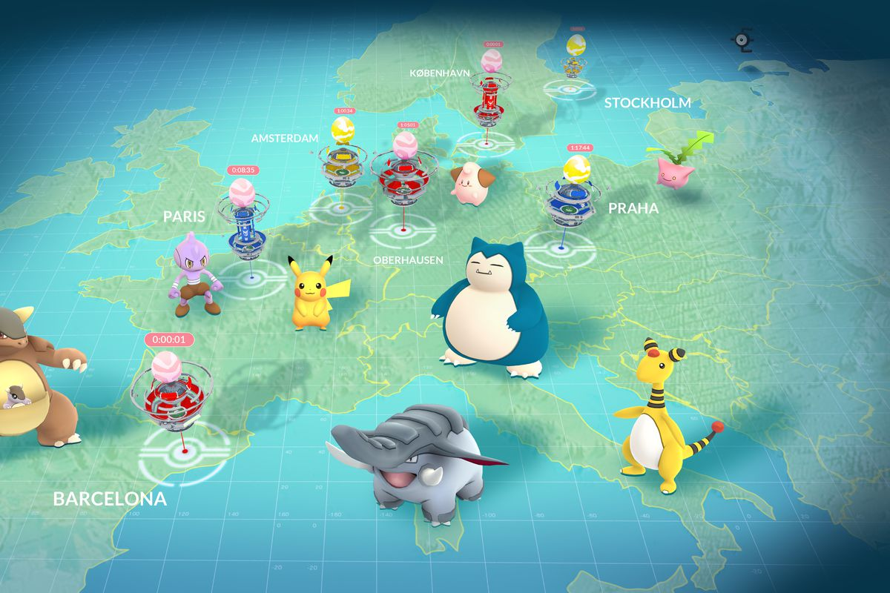

Slide 5


THE DATA

Slide 6

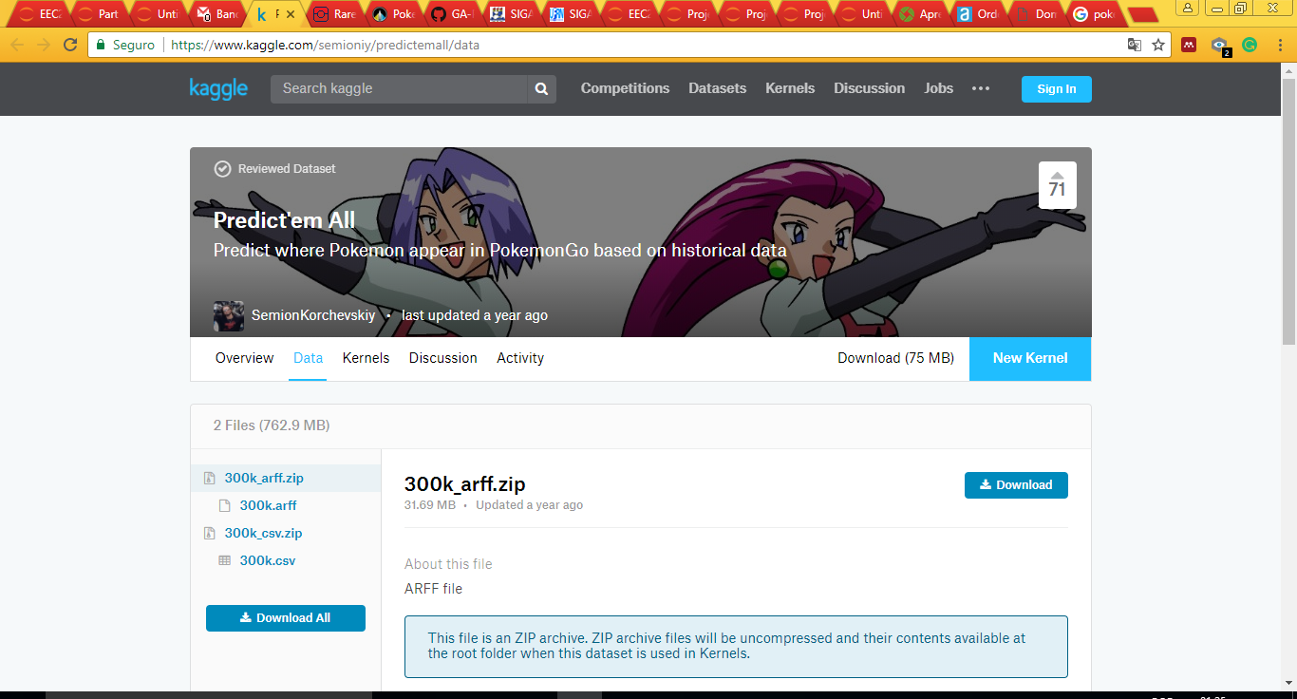
THE DATA
293,000 Pokémon sightings
(historical appearances)
https://www.kaggle.com/semioniy/predictemall/data

Slide 7

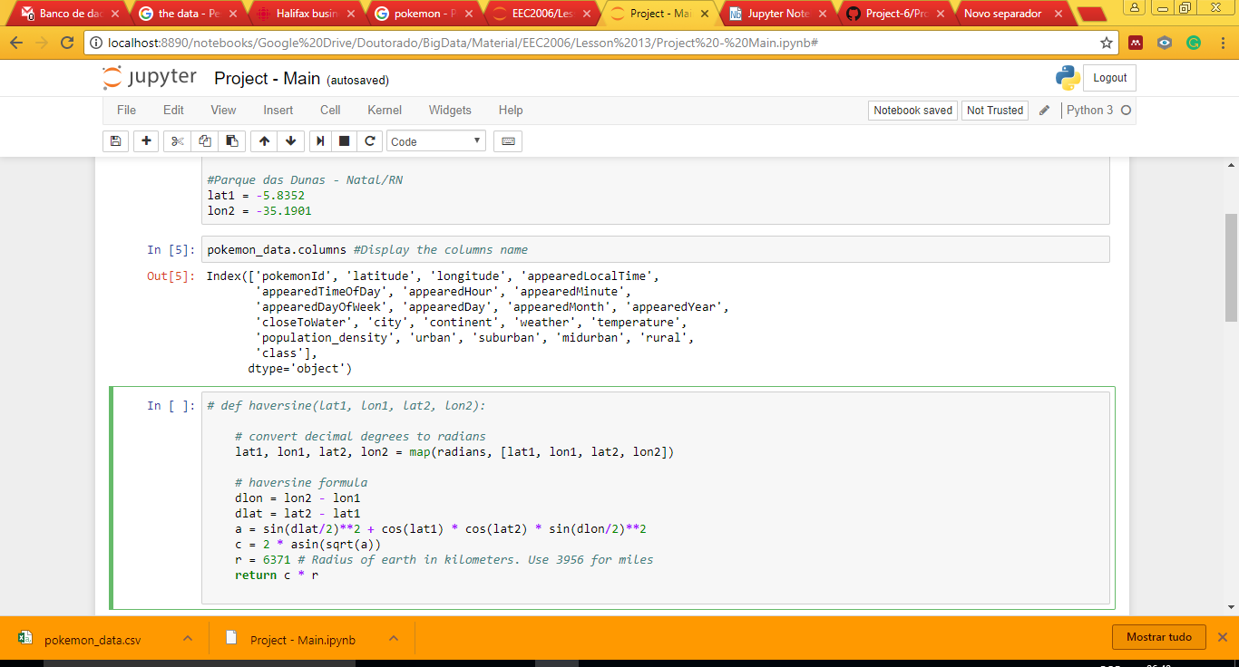
THE DATA

Slide 8
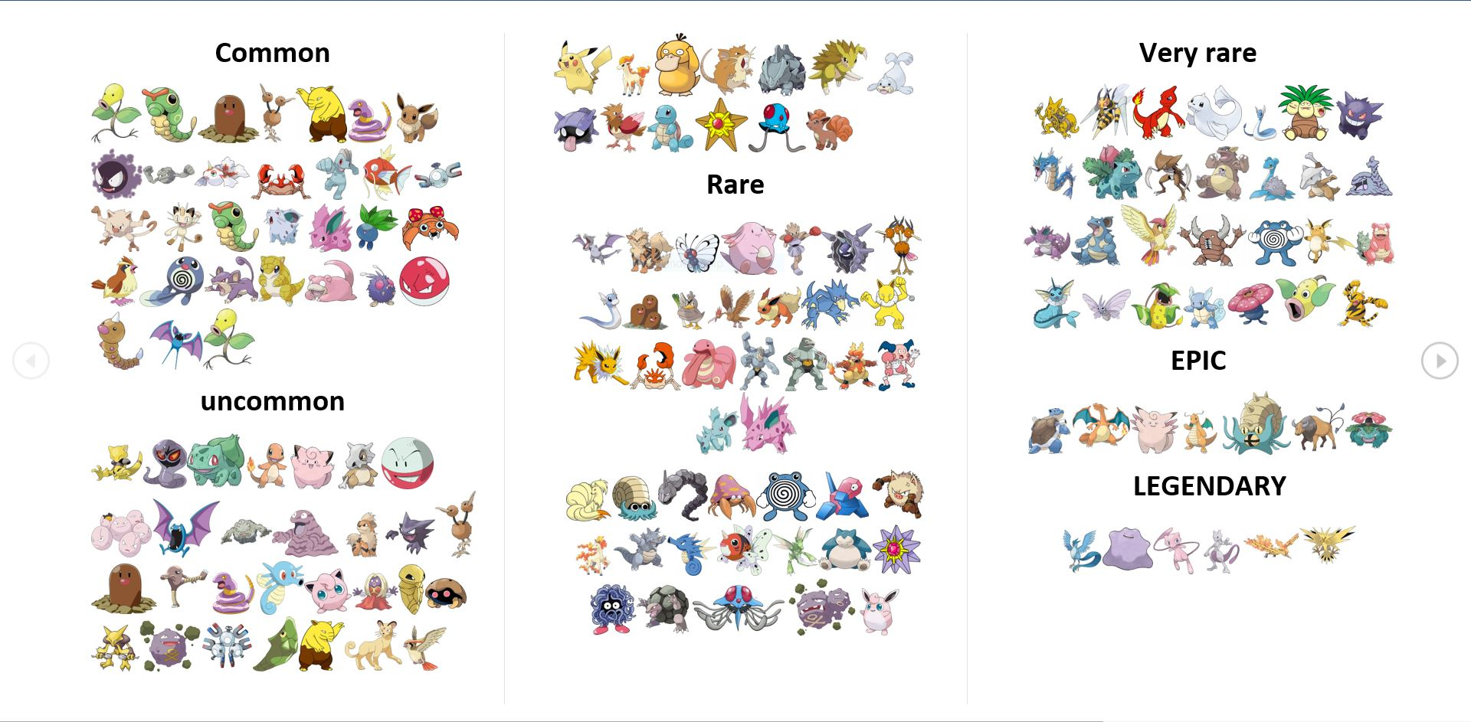
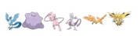
THE DATA
Super rare
http://www.pokego.org/rare-pokemon-list/

Slide 9
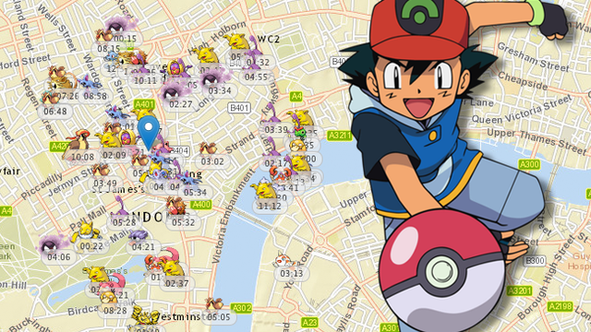

ANALYZING LOCATION

Slide 10

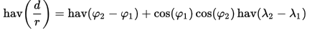
ANALYZING LOCATION
Latitude
Longitude
Geographic values like these aren't ordinal values
Latitude and longitude value pairs describe a point on a geographic coordinate system
The Harversine Formula

Slide 11
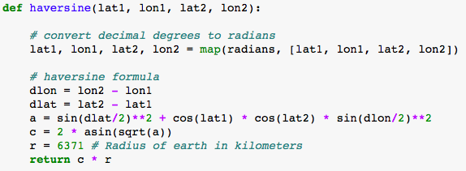
ANALYZING LOCATION
The Haversine Formula

Slide 12
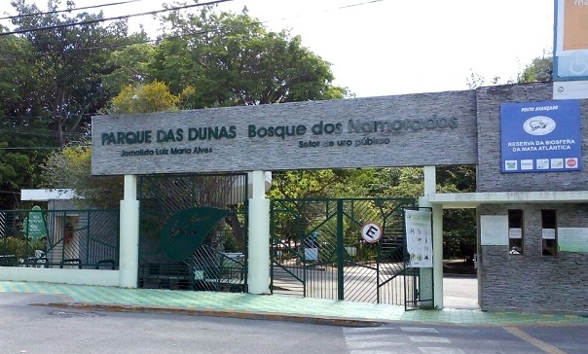
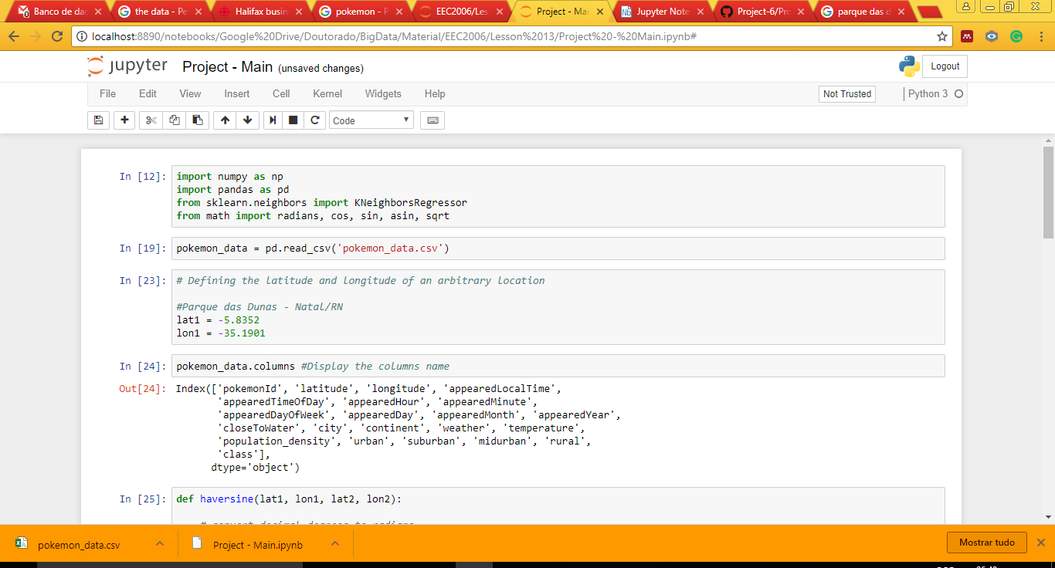
ANALYZING LOCATION

Slide 13
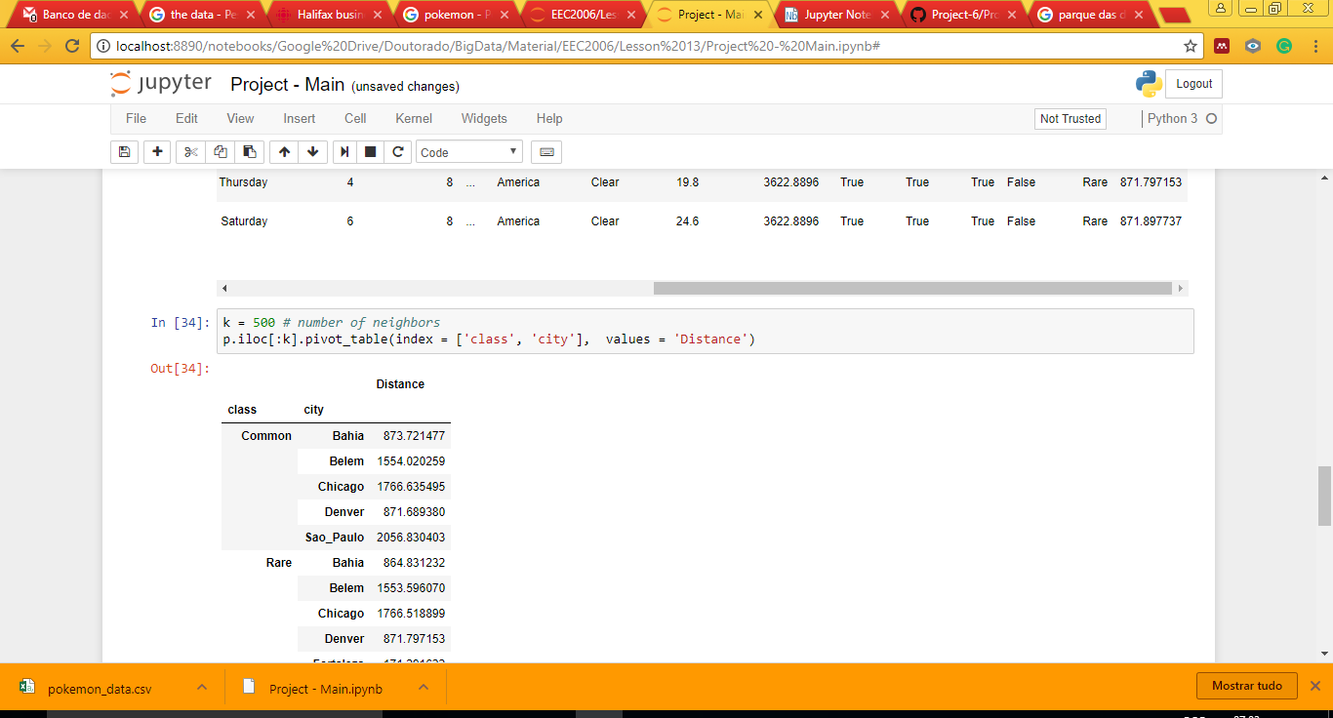
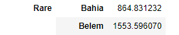
ANALYZING LOCATION
Nearest locations
Distance

Slide 14
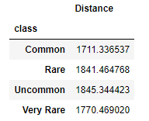
ANALYZING LOCATION
Pokémon class – general distance
class Distance

Slide 15


ANALYZING TYPES
Prediction

Slide 16

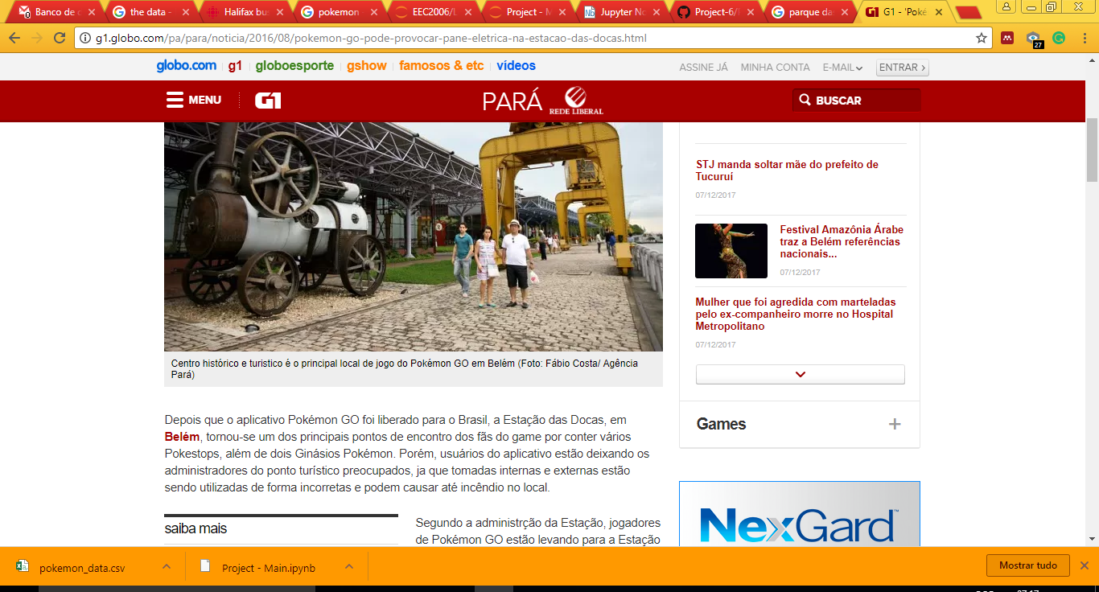
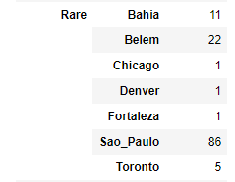
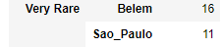
ANALYZING TYPES
http://g1.globo.com/pa/para/noticia/2016/08/pokemon-go-pode-provocar-pane-eletrica-na-estacao-das-docas.html

Slide 17
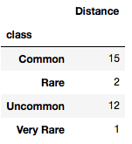
ANALYZING TYPES
Prediction
30 neighbors

Slide 18
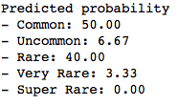
ANALYZING TYPES
Prediction
30 neighbors

Slide 19
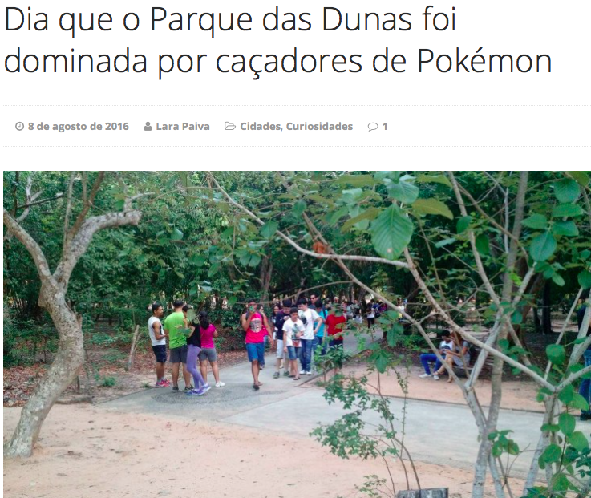
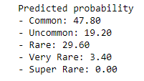
ANALYZING TYPES
Prediction
500 neighbors

Slide 20
QUESTIONS?

Slide 21
THANK YOU!

Slide 22


NATAL - RN

